Slide 1
Teaching advanced automotive electronics with open-source microcontrollers
Ralph F. Tate
Associate Professor
Automotive Technology

Slide 2
Motivation and Objectives
Many automotive technology students struggle with understanding electronics
Vehicles rely heavily on microcontrollers
Play and learn!
Objectives:
Increase skills and knowledge through hands-on exercises
Introduce students to coding
Motivate students to continue to explore!

Slide 3
What is a Microcontroller?
A small computer on a single integrated circuit (chip)
Typically "embedded" inside a device that they are programmed to control
A microcontroller is often small and low cost
www.mikroe.com/chapters/view/1

Slide 4
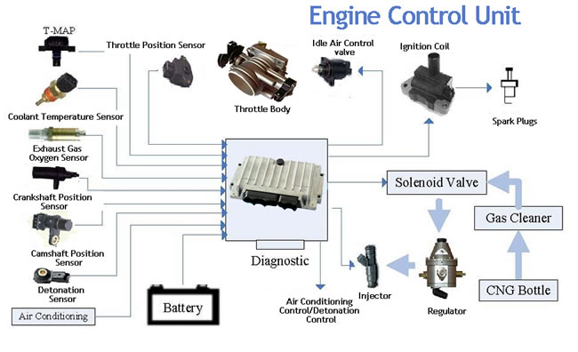

Slide 5
What is the Arduino?
todbot.com/blog/bionicarduino

Slide 6
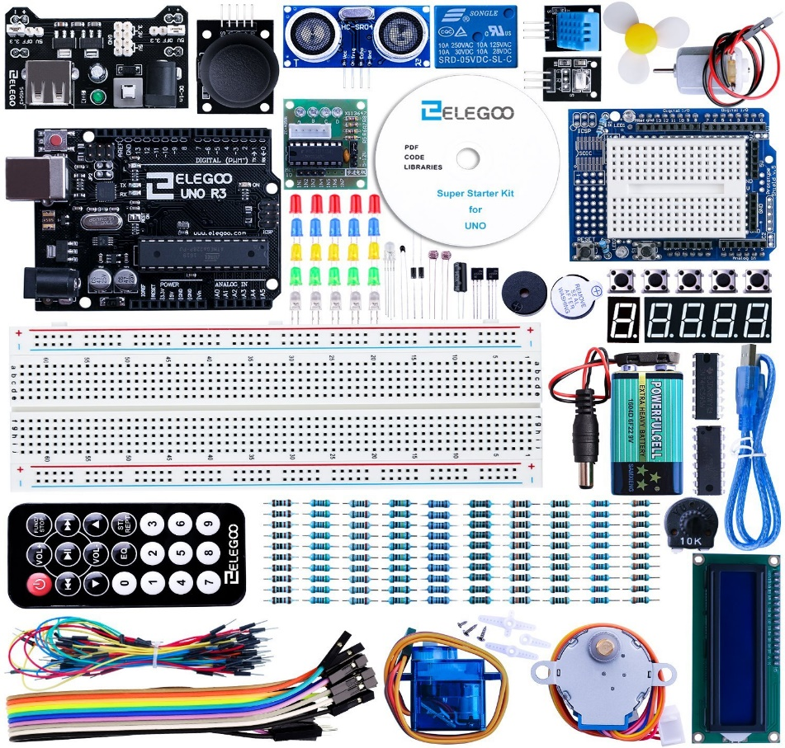
High-value, Low-cost Kits
Includes numerous sensors, actuators, indicators, motors, etc.
Easily adaptable to many automotive technology applications.
Students can work independently (online)

Slide 7
Progressive Exercises
Wiring an electronic circuit from schematic
Evaluating/testing an electronic circuit
Controlling an electronic circuit
Troubleshooting an electronic circuit
Current utilization
Instructor-guided introduction to HW and SW
Instructor-guided, student demo of basic sensor signal acquisition and display
Student demo of solution to assigned problems (synthesis)

Slide 8
Example: CAN bus data comm

Slide 9
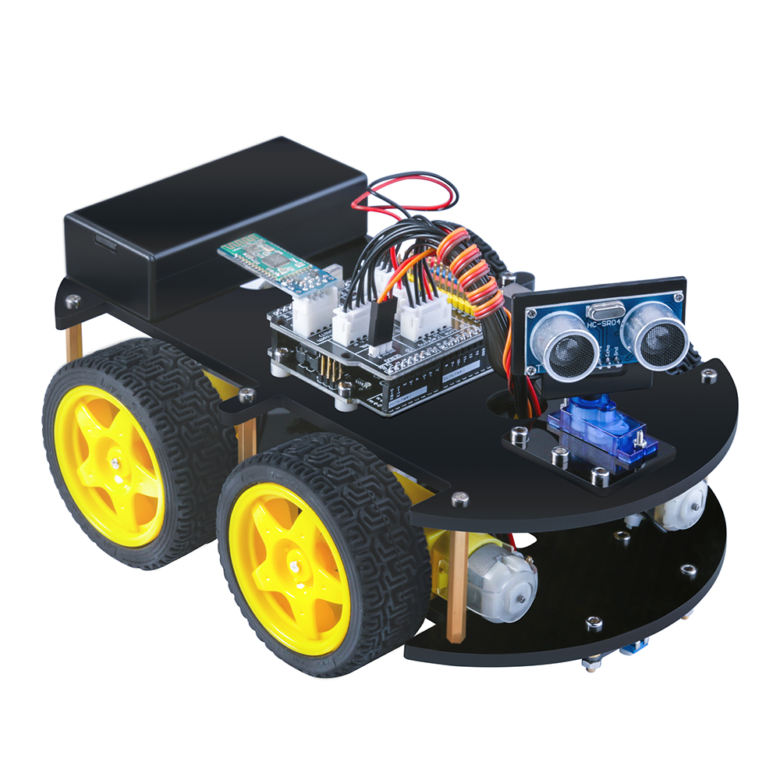
Future Direction
Train faculty
Increase student involvement in Arduino Development Group
Develop exercises to demonstrate autonomous technology

