Slide 1
Finding Future Aviators
Matt Romero
Steve Goetz
2018 CASA Flash Talk

Slide 2
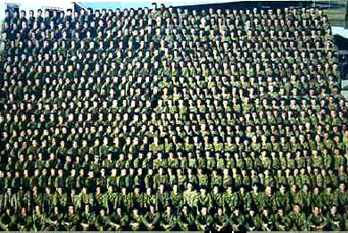
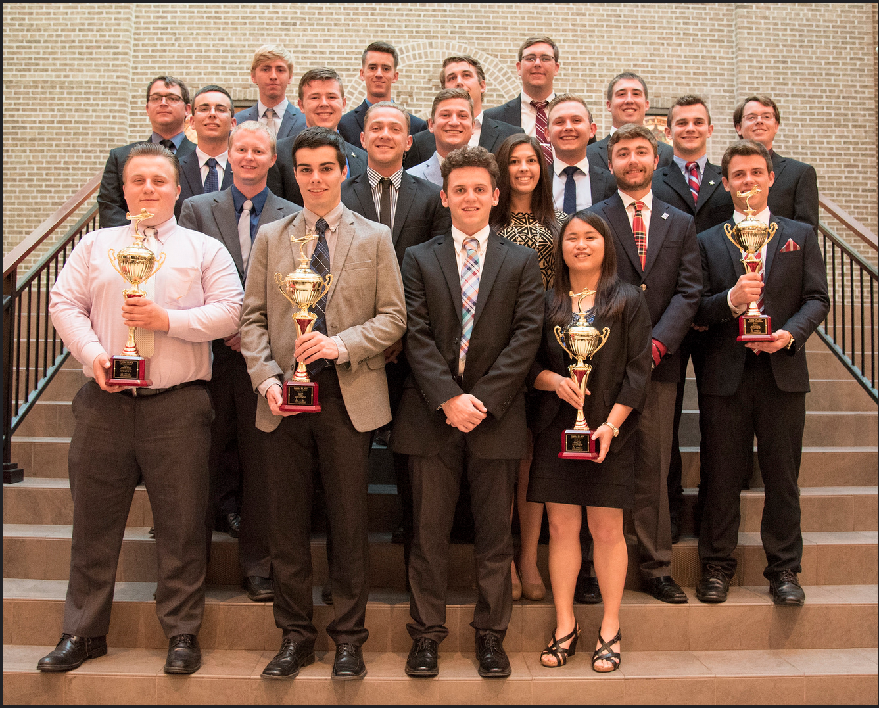
North American Airline Industry
U.S. Collegiate Flight Training Industry
Averaged only 1,394 new qualified pilots annually over the past decade
Needs approximately 5,746 pilots per year through 2036
(Federal Aviation Administration, 2017)

Slide 4
Research Design
Qualitative inquiry
Online survey
  Five demographic questions
  One open-ended question – “How were you introduced to aviation”
40 Participants (17.4%)
  Collegiate aviation student body
    Aviation Technologies
    Aviation Flight
    Aviation Management

Slide 6
Results – Paths to Aviation
Member of the family involved in aviation | Spoke to aircraft pilots
Introduced at a young age | WWII Literature
Member of the family worked for an airline | Military Service
Video Games | Member of the family served in the military
Commercial Air Travel | Experience in and around an airport
Aviation Camps | Youth Group
Air Shows | High School Advisor
United Airlines Career Day/Campus Visit | Watching aircraft fly
General Aviation | Family took them to work
Introductory/Discovery Flight | Mentor

Slide 8
College Choice Model (Hossleer, Braxton, Coopersmith, 1989)

Slide 9
Questions?

