Slide 1
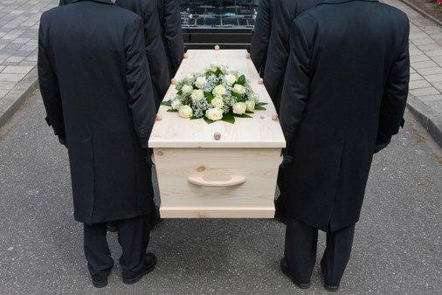
Millennials, Health Care Management, and Mortuary Science Robert Rados, Assistant Professor, Health Care Management, SIU Anthony T. Fleege, Associate Professor of Mortuary Science, SIU Abel Salazar, Clinical Instructor of Mortuary Science, SIU
Health Care Management and Mortuary Science have common concerns for support for dying persons and their families, within the hospice model of care.
Traditional funerals and the process of interacting with families has evolved over time, including business related issues and consumer related motivations (Beard, & Burger, 2017).
There exists a question of Alignment of changing traditions/differences in death attitudes, and practices of “Millennials” as consumers of Hospice & Funeral Services (Harvell, 2017).
Maladaptive DSM-5 diagnosis category or “Persistent complex bereavement-related disorder” is associated with many factors, but centers on understanding the sensitivity and differences in death attitudes (Bassett, 2017).

Slide 2
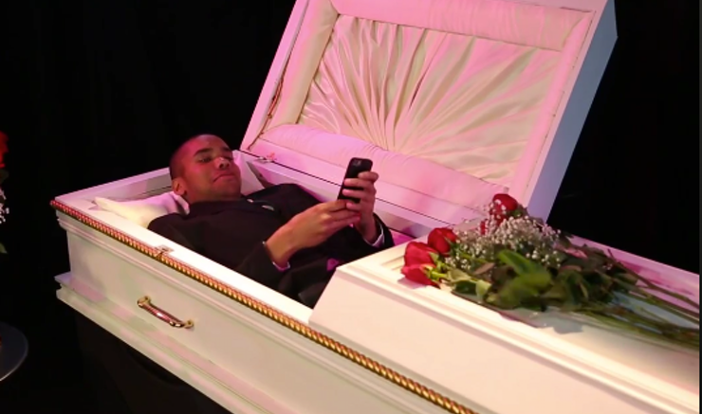
Millennials, Health Care Management, and Mortuary Science
Generational changes may likely effect Hospice Care & the Funeral Industry:
What will Millennials expect when it comes to how death and dying are handled?
How will end of life and Hospice Care be effected?
How will the Funeral Industry be effected?
How will academic programs be effected by future changes?
Proposed Methodology
Survey research, to gather current information from representatives of hospice, mortuary science/funeral homes, and millennials
To determine current alignment & changing traditions/differences in death attitudes / Death and Dying Scale

