Slide 1
Smart and Secure Computing
How can we increase our research performance even with very limited manpower and resource?
Introducing the current research projects of our research group
Sam Chung, Ph.D. Professor/Director
Information Systems & Technologies
School of Info. Systems & Applied Technologies
College of Applied Sciences and Arts (CASA)
Southern Illinois University Carbondale (SIUC), IL
Jun Kim, Ph.D. Assistant Professor/
Recreation Professions
Dept. of Public Health & Recreation Professions
College of Education & Human Services)
Southern Illinois University Carbondale (SIUC), IL

Slide 2
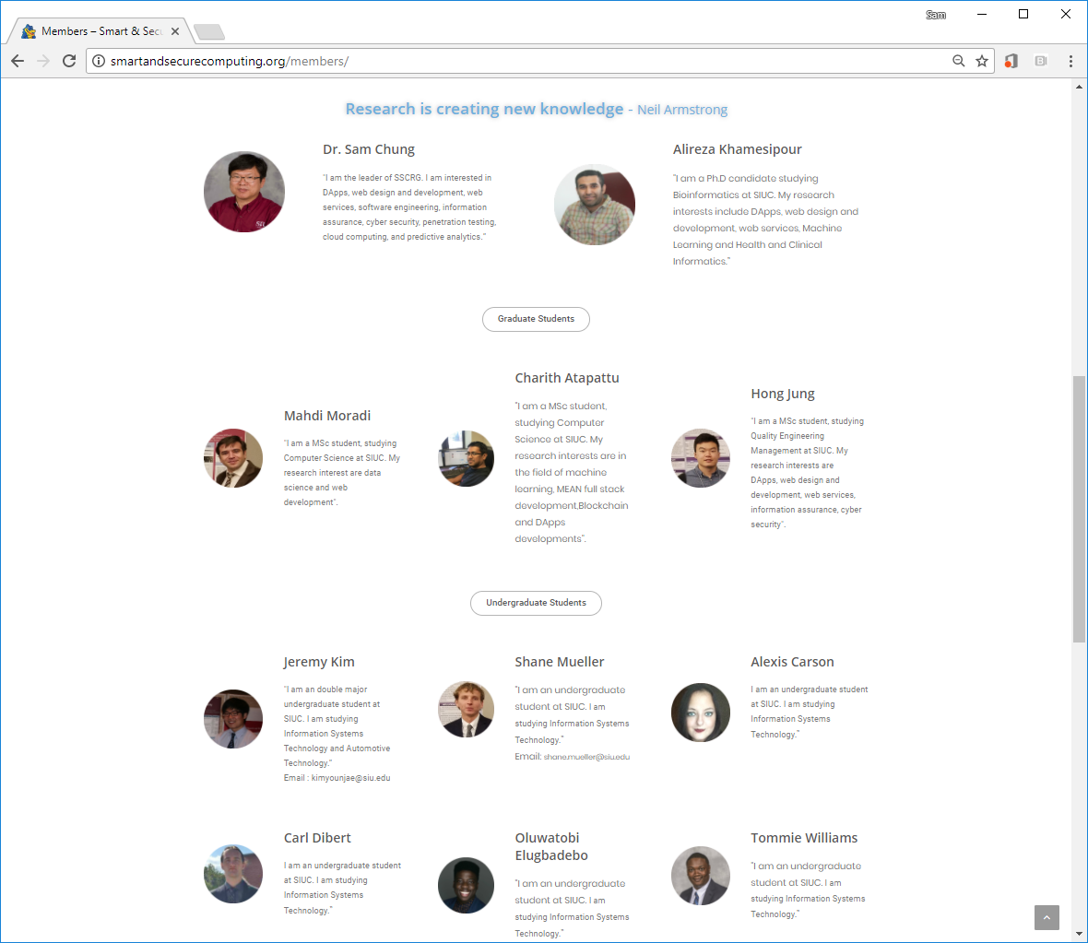
How to Conduct Your Research?
Why Research?
Securing Jobs
Creating Smart Jobs
Research Group
Skills
Student-Oriented Research
Knowledge
Abilities
3/21/2018 (Wed.)
Sam Chung @CASA Research Flash Talk

Slide 3
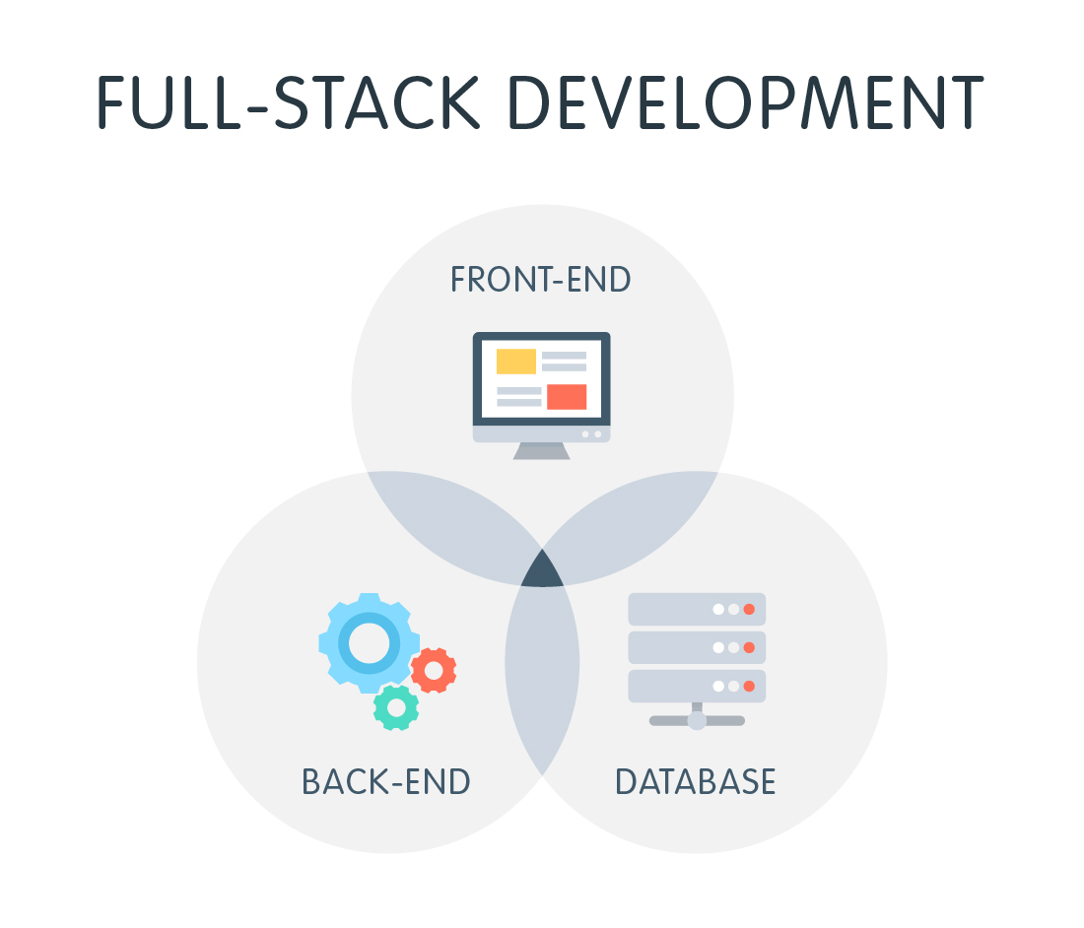
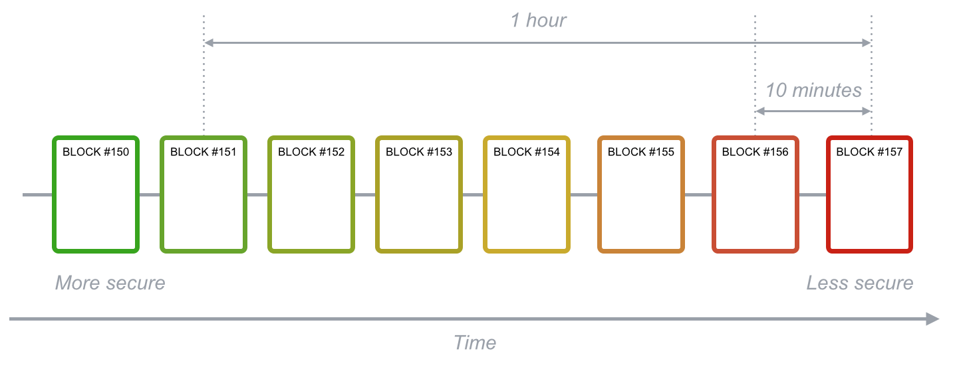
How to Conduct Your Research?
Emerging Technologies
Full Stack
Blockchain
3/21/2018 (Wed.)
Sam Chung @CASA Research Flash Talk

Slide 4
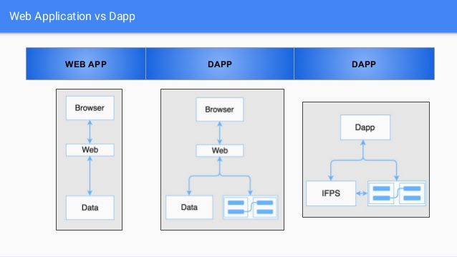
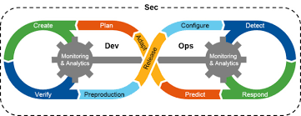
Current Research Projects
DevSecOps
App & Dapp
3/21/2018 (Wed.)
Sam Chung @CASA Research Flash Talk

Slide 5
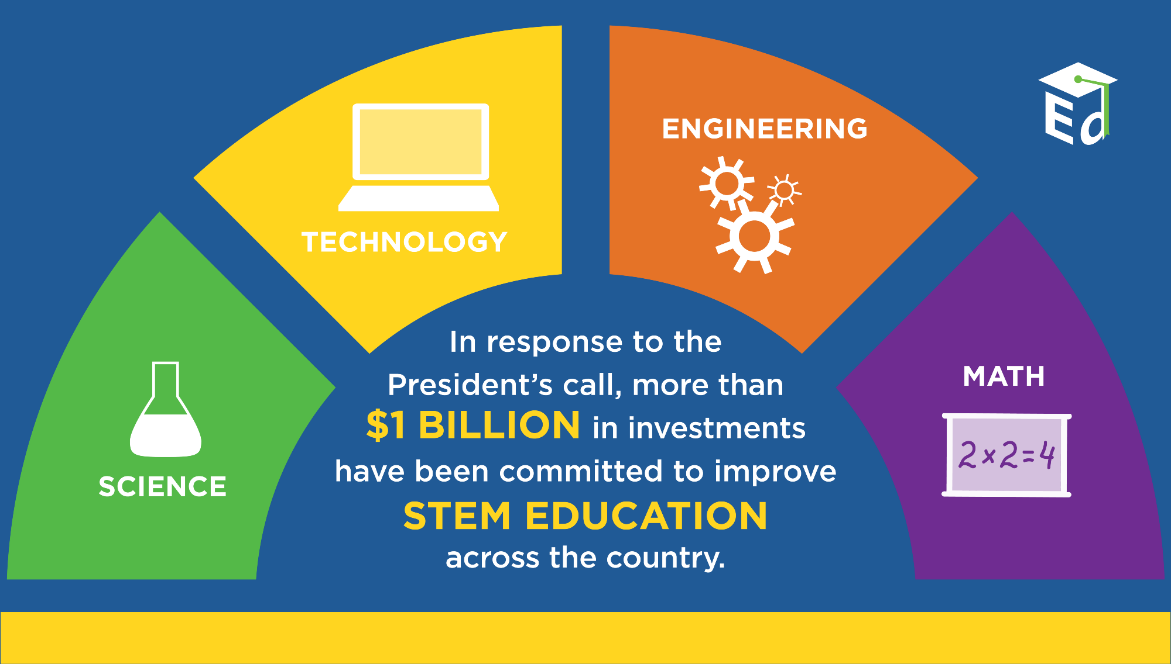
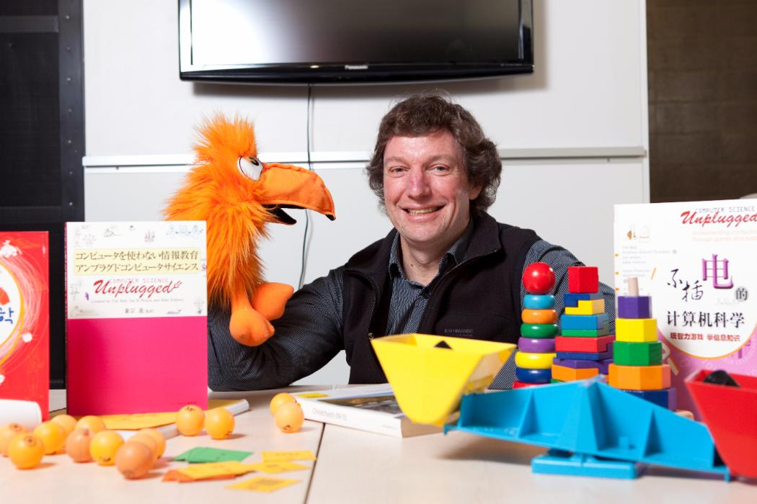
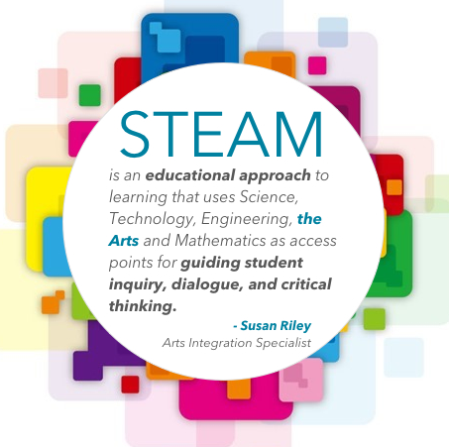
“
”
Tim Bell, Ph.D. Computer Science and Software Engineering
The STEAM Journal (Henriksen, 2017)

Slide 6
Current Research Projects
Smart & Secure IdM
Design Pattern
Compensating Control
Blockchain
3/21/2018 (Wed.)
Sam Chung @CASA Research Flash Talk

