Slide 1
Development of an Online Free Automotive Textbook
Sean Boyle
Automotive Technology

Slide 2
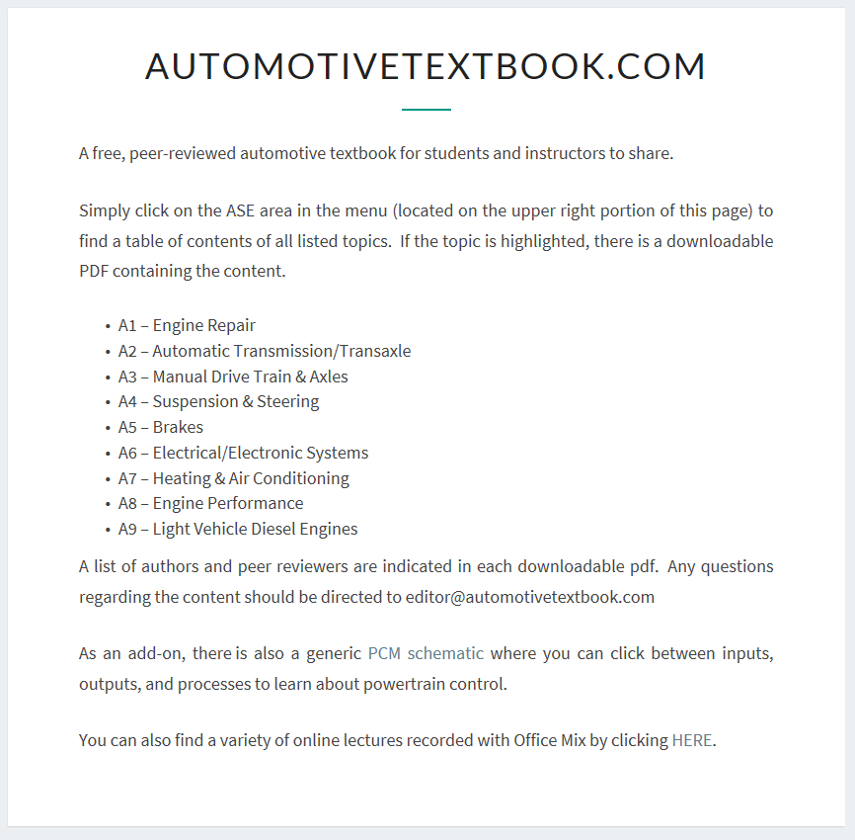
Goal: To provide a free textbook type resource for Automotive Technology students worldwide
New textbooks can cost a student over $150 each
Many textbooks contain irrelevant, outdated, and unnecessary content
Students often complain that instructors don’t use the textbook that cost them so much money

Slide 3
Divided into the nine major Automotive Service Excellence (ASE) areas
Sections are divided into the nine ASE areas where automotive students attempt certification

Slide 4
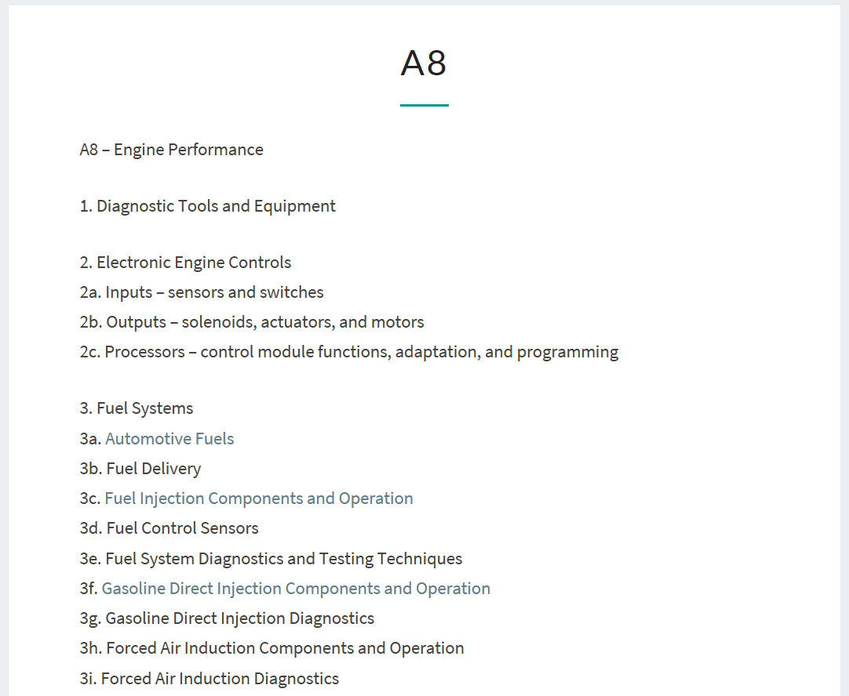
Each section has a “textbook like” chapter layout
Each section can be downloaded and printed as a PDF

Slide 5
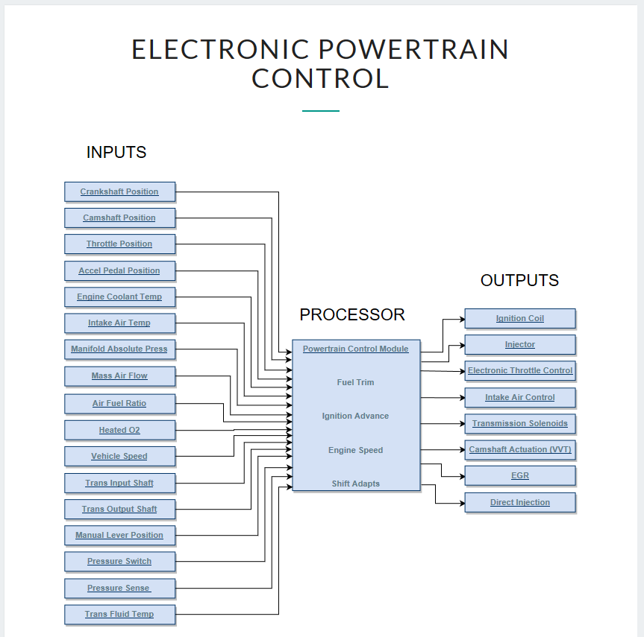
A few extras - including module schematics and quick references
Quick access information that allows the students to visualize the various management systems on a vehicle

Slide 6
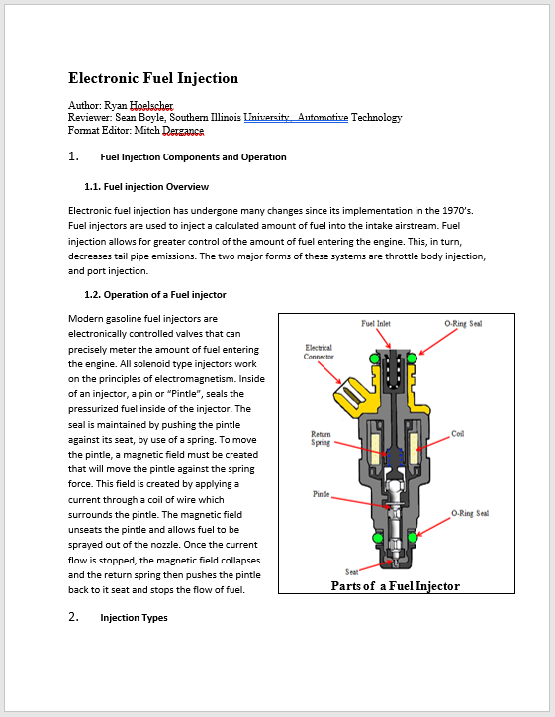
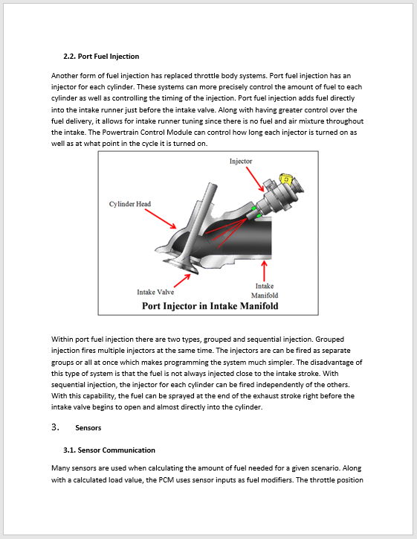
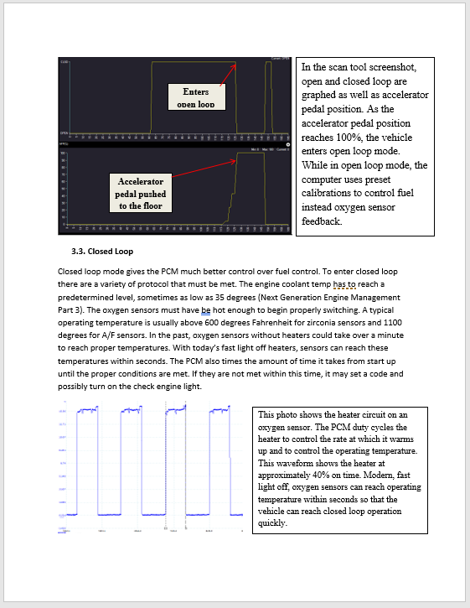
Students contribute by completing chapters and having them peer-reviewed
Peer reviewed by industry professionals, automotive trainers and educators
Students work “lives on” and doesn’t live and die as a project for a class

