Slide 1
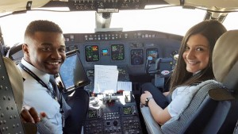
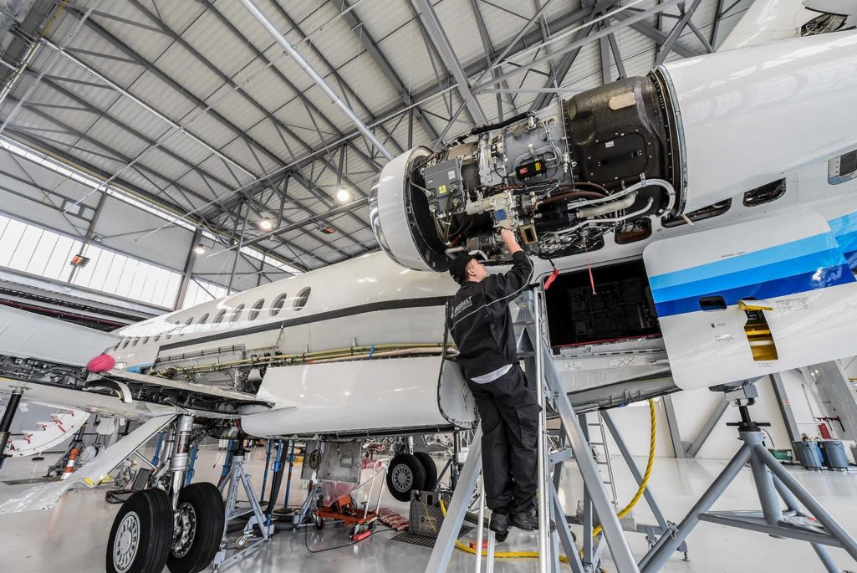
Responding to the worldwide pilot and aircraft technician shortage

Slide 2
Pilot Aircraft Technician Shortage
Boeing forecasts that between 2017 and 2036, the world's commercial aviation industry will require approximately:
637,000 new commercial airline pilots
648,000 new commercial airline maintenance technicians
839,000 new cabin crew members
Region | New Pilots | New Technicians | New Cabin Crew
Asia-Pacific | 253,000 | 256,000 | 308,000
Europe | 106,000 | 111,000 | 173,000
North America | 117,000 | 118,000 | 154,000
Latin America | 52,000 | 49,000 | 52,000
Middle East | 63,000 | 66,000 | 96,000
Africa | 24,000 | 23,000 | 28,000
Russia / CIS | 22,000 | 25,000 | 28,000

Slide 3
Pilot Aircraft Technician Shortage
Aircraft Technician Shortage
A bipartisan group of U.S. senators has just introduced legislation to address the technician shortage issue posing a threat to the long-term health of the country’s aviation maintenance industry.
Under the proposed bill, grants of up to $500,000 per year would be available for businesses, unions, schools and government entities partnering to pursue creative solutions to the technician shortage.
Median aircraft mechanic (jet) salary is $83,057
With a range between $72,382-$93,619

Slide 4
Pilot Aircraft Technician Shortage
Pilot shortage – Felt most at the Regional Airlines.
Demand at the major airlines is expected to grow as thousands of pilots at American, Delta, United and Southwest hit the U.S. mandatory pilot-retirement age of 65 in the next several years.
Last year, Horizon Air was forced to cut back the number of flights to many Pacific Northwest cities because it didn’t have enough pilots.
Last summer, Alaska Airlines subsidiary Horizon Air canceled more than 300 flights over two months for lack of pilots.
Republic Airways filed for bankruptcy protection in 2016, citing a pilot shortage that forced it to ground flights.

Slide 5
Pilot Aircraft Technician Shortage
Best “seller’s market” for pilots in 30 years.
Salary Trends:
Pilots who become captains on jumbo jets that fly international routes can earn more than $300,000 a year.
A few years ago, starting pay for first officers or co-pilots at regional airlines was in the low $20,000s. With bonuses and higher hourly rates, some regionals now offer starting pay of $80,000 or more, with signing and retention bonuses.
Examples of current signing bonuses for Regional airlines:
Endeavor Airline $30,000
Piedmont Airline $32,000
Envoy Airline $22,000 plus $20,000 retention bonus per year
Trans State Airline $44,000
Envoy Airline $45,000

Slide 6
Pilot Aircraft Technician Shortage
All sectors impacted by the shortage.
USAF rolls out $455,000 retention bonus over 13 years for fighter pilots. ($35,000 per year)
Many US Airlines are paying retention bonuses to pilots of up to $35,000 per year.

