Slide 1
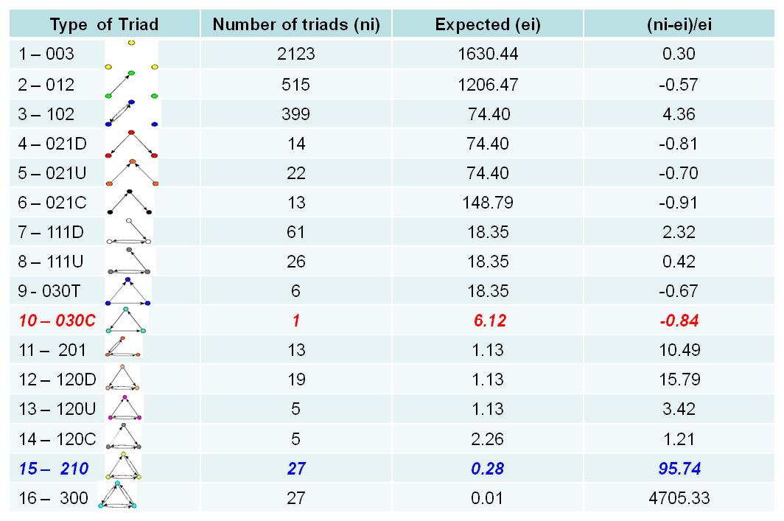
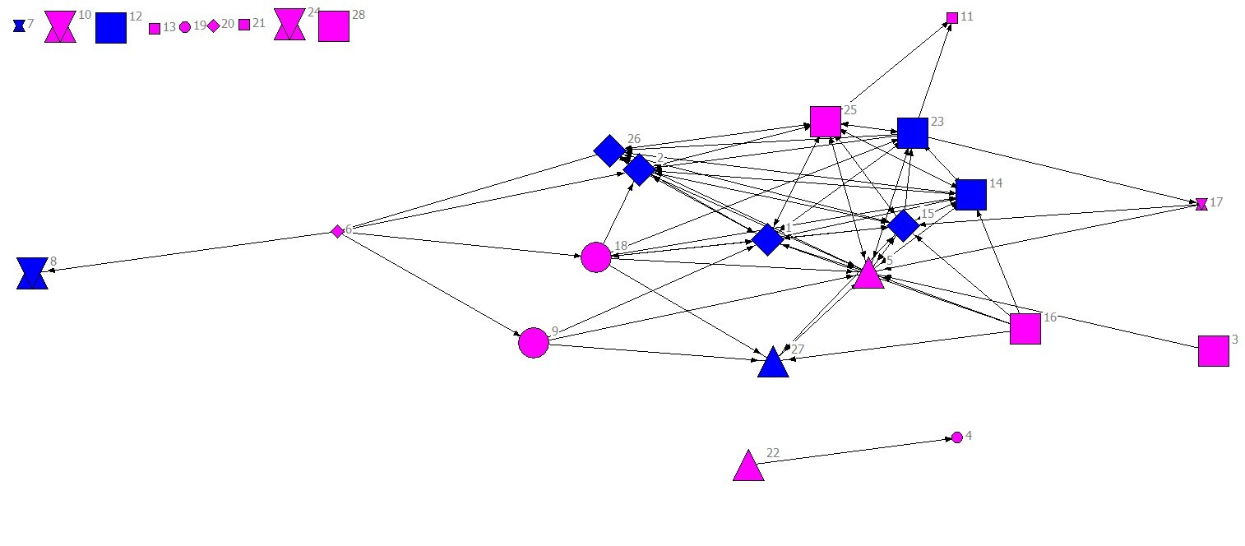
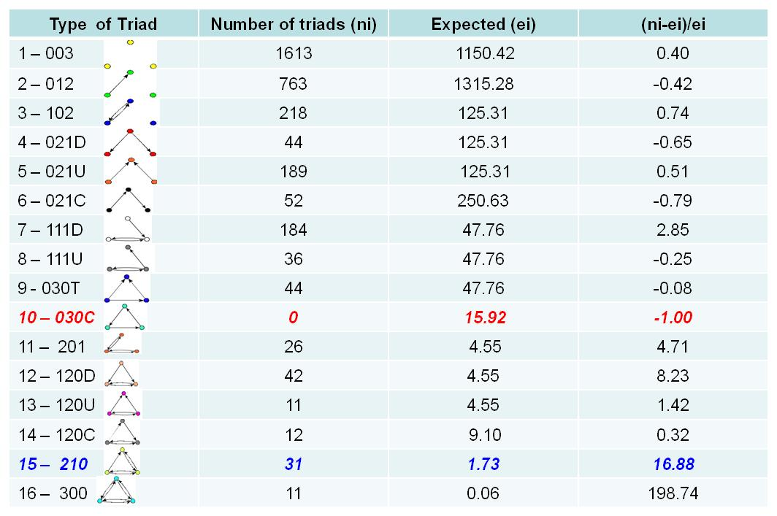
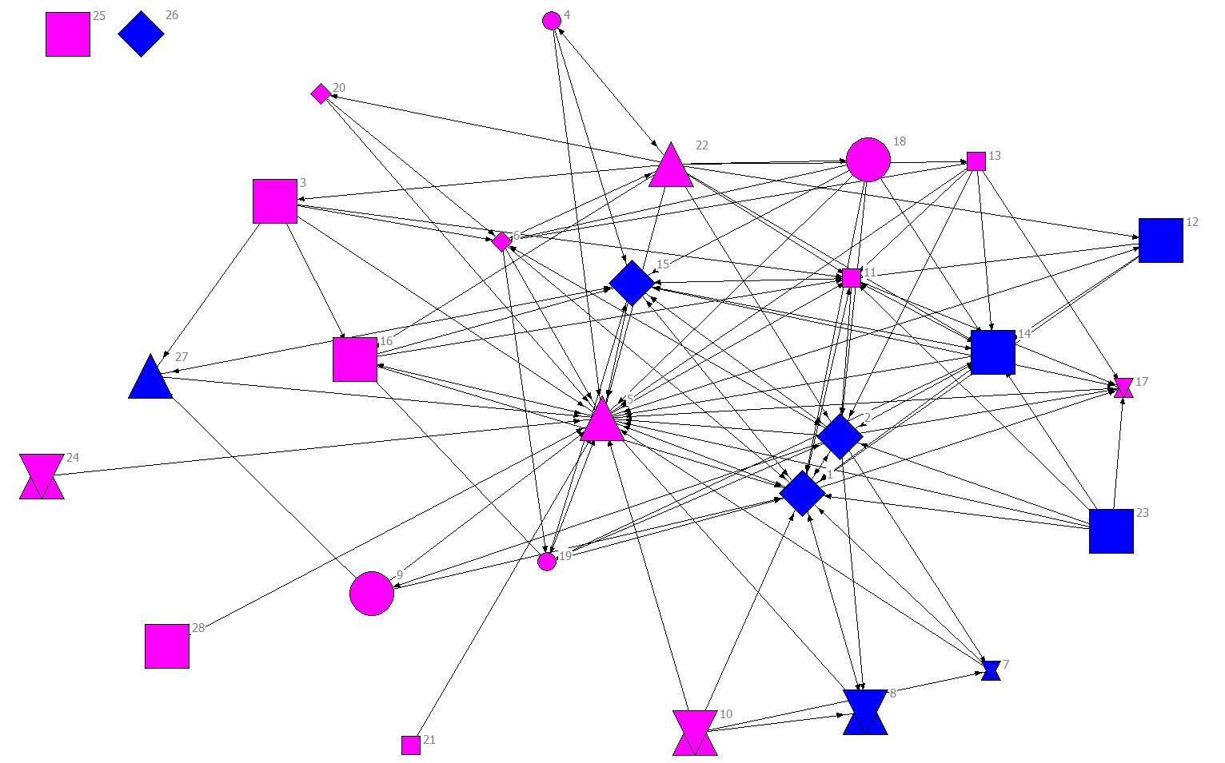
Table 2. General Information about the STEM NHS Networks
What Can Triadic Census Tell Us about the Development of Public Management Networks?
Aleksey Kolpakov¹ and Michael McGuire¹
¹School of Public and Environmental Affairs, Indiana University
avkolpak@indiana.edu
Introduction
Results
As Saint-Onge and Armstrong (2004) have noted, the capability to effectively manage complex partnerships is growing in importance as organizations are reconfigured on internally and externally conductive bases. Organizations are becoming more and more involved in complex value-creation networks, where the boundaries between one organization and another become blurred and functions become integrated. This study shows how a STEM (science, technology, engineering, and mathematics) small school, Metro High School in Columbus, Ohio, was built by and continues to operate as an integrated network involving persons from the non-profit sector, school administrative staff, leaders from academia, and members of the greater Columbus community. This study describes and explains the network operations that emerged throughout the development of the school and that now exist during the operation of Metro School. This network analysis thus focuses on lessons learned from the formulation of the Metro concept, its implementation, and the collaborative structure of the network that maintains broader support for the school.
General Description of the Networks
Triadic Census of Planning Network
 | Pre-project | Planning | Implementation
Density | 7 % | 11 % | 16%
Reciprocity | 23 % | 46 % | 26%
Transitivity | 36 % | 64 % | 46%
Visualization of Planning Stage Network
Triadic Census of Implementation Network
Methods
University
Foundation/Enterprise/Partnership
Network High School
School Districts
Learning Centers
Gender: Blue – males; Pink – females
The current study uses the qualitative and quantitative data collected by Robert Agranoff and Michael McGuire, School of Public and Environmental Affairs, Indiana University, as the part of an evaluation study of Metro School in 2008.
The qualitative data are represented by semi-structured interviews with 28 key representatives of 17 organizations involved in the network school project.
These 28 key representatives were identified by the snow-balling technique based on initial discussions with Metro School staff.
The quantitative data were gathered by means of two-page surveys, where each respondent was asked to identify up to 16 individuals that were important in terms of involvement with Metro School. Fifty-seven representatives responded to the survey.
Using the results of the qualitative data and items from the survey we constructed the directed network of 28 actors of 17 organizations involved in the Metro School at three time points: pre-project stage, the planning stage and the implementation stage
UCINETTM and NETDRAWTM were used to conduct social network analysis of the directed networks at the descriptive level.
PAJEKTM was used to conduct triadic census analysis for the planning and implementation networks.
Visualization of the Implementation Stage Network
Conclusions
The analysis of triads in the planning and implementation stages of the Metro School project shows some patterns of structural configurations of the network depending on the stage of network development.
The Metro school network at the stage of planning exhibited a structural tendency towards hierarchy because of the large number of transitive triads (210 triads).
Analysis of cyclical triads (030C triads) in both project stages indicates the impediment of information flow in the network, especially in the implementation stage.
University
Foundation/Enterprise/Partnership
Network High School
School Districts
Learning Centers
Gender: Blue – males; Pink – females
Reference: Contractor, N., Wasserman, S., and Faust K., 2006. Testing Multitheoretical Multilevel Hypotheses About Organizational Networks: An Analytical Framework And Empirical Example. Academy of Management Review 31(3): 681-703

