Slide 1
Animating Your Presentations
By: Omar Trinidad
Southern Illinois University Carbondale

Slide 2
Common Mistakes
Smart Art & Links
Animation
Notes:
Objectives: By the end of this presentation you will be able to:
Avoid common mistakes made of Power Point presentations.
Enhance your presentations using the smart art and link functions.
Utilize animation functions.

Slide 3
Common Mistakes
Too Much Text
Students cannot focus on the instructor
Text Too Difficult to Read
Background or text color
Too Complicated
Notes:
Too much text
The student will take most of their time reading and writing the slide.
The students stare at the board rather than paying attention to the instructor.
Text too Difficult to Read
The best is to use a lighter back ground with darker text.
Try to avoid having pictures in the background.
Too Complicated
Too much animation will distract more than enhance.
Sound can be used to get attention but it might also distract.

Slide 4
Too Much Text
Notes:
Notice several things:
The title can be shortened .
The text looks like it was copied and pasted.
There are 7 sentences in one bullet point.
The sentences can be shortened.

Slide 5
BATTERY RECHARGE CYCLE
Alternator charges the battery
Positive and negative plates return to previous state
Lead Dioxide (Positive) Lead (Negative)
Specific gravity increases
Electrical energy turns into chemical energy

Slide 6
Too Much Text
Notes:
Notice several things:
The title can be shortened .
The bullet points are not direct and succinct.

Slide 7
Text Too Difficult to Read
Notes:
Notice several things:
The background consists of light and dark colors.
The font color is too dark.
A picture can be added on the side or on the next slide if needed.

Slide 8
Text Too Difficult to Read
Notes:
Notice several things:
The background and font combination would work except for the picture in the middle.
The sub points can be shortened.

Slide 9
Smart Art & Links
Process
Diagnostic Procedure
Repair Procedure
Flow Charts
Relationships
Notes:
Convert Normal Text into Smart Art
Click on the “Home” tab
Click on the “Convert to SmartArt” option on the ribbon
Choose from the following Smart Art options

Slide 10
Electrical Diagnostic Steps
Verify the Complaint
Visual Inspection
Gather Diagnostic Information
Test
Repair and Verify
Gather Vehicle Information
Notes:
Creating a Hyperlink on a Text
Select the text
Press the Right Mouse button
Choose the “Hyperlink” option
Choose the “Place in This Document” option
Choose a slide to link to
Press the “Ok” button

Slide 11
Gather Vehicle Information
Year, Make and Model
Odometer
VIN
Notes:
Creating a Hyperlink on an Object
Select the Object
Press the Right Mouse button
Choose the “Hyperlink” option
Choose the “Place in This Document” option
Choose a slide to link to
Press the “Ok” button

Slide 12
Animation
Schematics
Illustrate current flow
Graphics
Expand from one picture
Notes:
Schematics
Electrical, hydraulic, or vacuum schematics can be used.
Animating the schematics will enable the students to follow the flow.
Sometimes students forget where the flow stared.
Graphics
Pictures are worth a thousand words
Pictures can be expanded to show internal or external parts.
A mouse or electronic pen can be used to highlight portions of the picture.

Slide 13
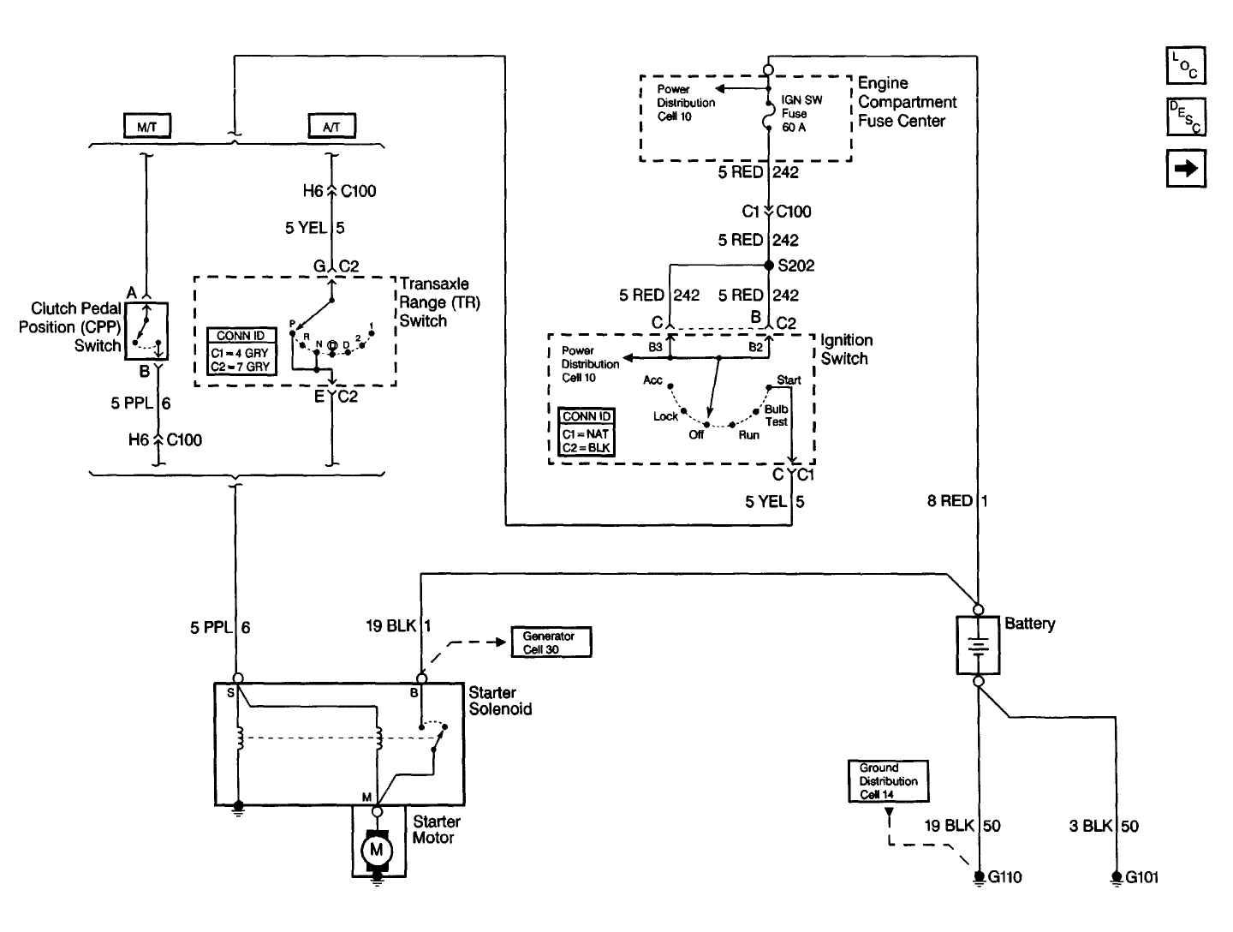
Notes:
This allows the students to see the electricity that is flowing through the system.
The Instructor can use different colors to correspond to different types of charges or pressures.
Switches can be turned to the various positions.
The instructor can start to ask diagnostic questions.

Slide 14
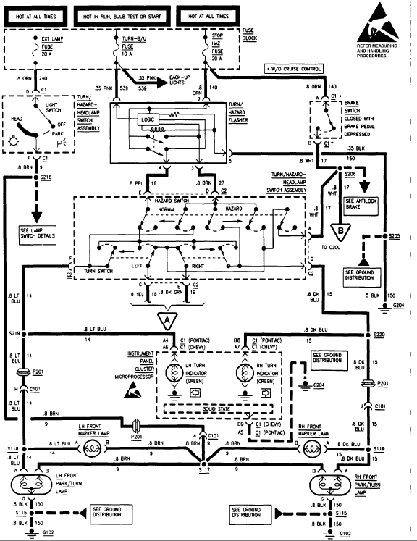
Notes:
It allows the instructor to explain difficult schematics.
Other lines can be added to symbolize actions such as a light bulb turning on.

Slide 16
Diode in action
N
Depletion Zone
P
-
-
+
+
+
-
-
+
+
+
+
+
+
+
+
-
-
-
-
-
-
-
+
+
+
-
+
-
-
+
-
+
-
+
-
+
-
+
-
+
-
BATTERY
Notes:
Animation is a great way to explain something that is unseen.

Slide 17
Find the Input Components
Notes:
Images can be expanded to illustrate what they will see in lab.
Covers can be quickly removed to show the rest of the components.

Slide 18
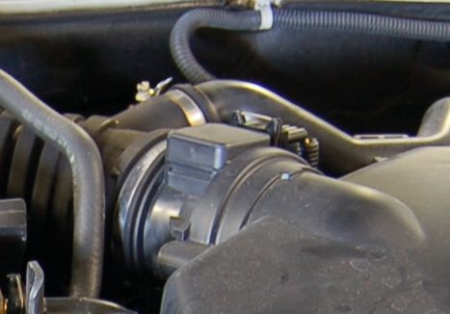
Find the Input Components
Mass Air Flow Sensor
Notes:
Parts of the pictures can be magnified.

Slide 19
Find the Input Components
Throttle Position Sensor

Slide 20
Animating Schematics
Prepare the background
Insert lines
Animate the Lines
Insert other objects

Slide 21
Preparing the Background
Keep the background
Format the Picture if needed
Use the slide efficiently
Notes:
Slide Formatting
Click on the “Home” tab on the ribbon
Click on the “New Slide” option
Do not click on the box with the yellow sparkle. It will automatically create a slide with a previous format.
Choose the “Blank” option
Background Formatting
Right click on the background
A Format Background window will open
Choose “Format Background”
Click “Picture or texture fill”
Click on the “File” button
Choose a picture in file and click the “Insert” button
Check the “Hide background graphics” box
Zero the offsets on the “Stretch options”
Click the “Close” button

Slide 23
Inserting Lines
Choose brighter colors
Make the lines thicker
Use Copy and Paste
Add arrows if needed
Notes:
Inserting Lines
Click on the “Insert” tab on the ribbon
Click on the “Shapes” button
Choose a line from the “Lines” option
Lines without ends are the best to use
At this point the Cursor will look like a plus sign: +
Click and hold the left mouse button at the desired beginning point of the line
Drag until the desired length is achieved and release the mouse button
Create a horizontal and vertical line
These lines will be copied and pasted after being formatted to save time
Formatting Lines
Right click on the line
Choose the “Format shape” option
A Format Shape window will open
Click on the “Line Color” option
Click on the “Color” box and choose the desired color
Click on the “Line Style” Option
Change the “Width”
This will depend on the amount of space on the schematic
4 point works the best
Arrows can be added by choosing from the “Arrow settings”

Slide 24
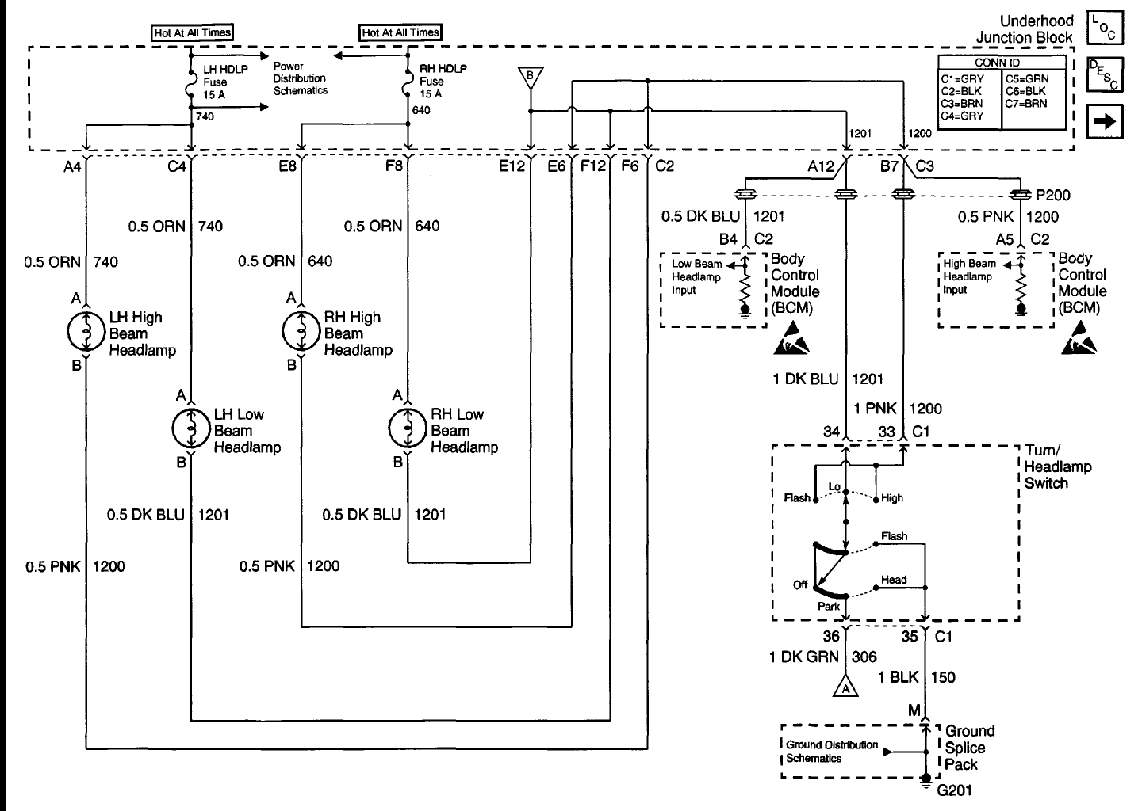

Slide 25
Animating the Lines
Keep it simple
Time Consuming
“Wipe” Effect
Notes:
Animation Formatting
Click on the “Animations” tab on the ribbon
Click on the “Custom Animation” button
The Custom Animation window will open on the right side of the screen
Click on the first line that you want to animate
Click on the “Add Effect” button
Choose “Wipe” from the “Entrance” option
Change the direction based on where you want the line to come from.
Multiple Line Formatting
Hold the “Control” key on the keyboard
Click on all the lines that you want to format
Add an effect on all the lines.
You will have to change the start option for each line based on when you want the animation to start.
Starting after previous works with long animations
Select all the line animations for quick animation formatting
Click on the first line you want to formant in the Custom Animation window
Hold the “SHIFT” key on the keyboard
Click on the last line you want to format
Format the animation as needed

Slide 27
Inserting Other Objects
Replacing objects
Switches
Other lines
Simulating an action
Sound
Action
Notes:
Making the Arrow Disappear
Click on the “Insert” tab
Choose the Shapes option on the ribbon
Choose the line with an arrow at the end
Draw the arrow pointing towards the position desired
Format the line to mirror the original switch
Right Click on the line and choose “Format shape”
Format the line to best suite the original switch
Click on the “Insert” tab
Choose the “Shapes” option on the ribbon
Insert a rectangle shape to cover the original switch
Format the rectangle so that the box is completely white
You will have to change the fill color and the line color to match the background
Select the rectangle and the arrow
Click on the “Add effect” button on the Custom Animation window.
Choose the “Appear” option
Changing the Line Colors on the Same Slide
Select the lines that need to be changed
Hold the “Control” key on the keyboard and click on the desired lines
Copy and Paste
Notice that the animations are also copied and pasted
Paste the lines with the color desired over the undesired lines
Verify the Animations
Inserting Other Lines Illustrate Action
Insert a line next to the object that you want to illustrate action from
Format the line to the desired color and width
Copy and Paste until desired amount is reached
Select the Lines and add effect

Slide 29
29

Slide 30
Animating Objects
Prepare the Background
Insert Object
Animate Objects

Slide 31
Preparing the Background
Similar to animating schematics
White
Insert picture background if needed
Notes:
Background Formatting
Right click on the background
A Format Background window will open
Choose “Format Background”
Click “Solid fill”
Change the color
Check the “Hide background graphics” box
Click the “Close” button

Slide 33
Inserting Object
Format the shapes
Less is sometimes better
Add text if needed
Notes:
Inserting Objects
Click on the “Insert” tab on the ribbon
Click on the “Shapes” button
Choose a shape in the “Shapes” tab
Click and hold the left mouse button at the desired beginning point of the shape
Drag until the desired size is achieved and release the mouse button
Create all the shapes that you need to animate
Formatting Objects
Right click on the object
Choose the “Format shape” option
A Format Shape window will open
Click on the “Fill” option
Choose the type of fill you would like to have for each object
Click on the “Color” box and choose the desired color
Other options are available to enhance the visual appearance of the object
Cropping Pictures
Double click the picture
Click on the “Crop” button on the ribbon
Black marks will show around the border of the picture
Move the marks to the desired size of the picture
Click away from the picture when finished

Slide 35
Animating Objects
Use “Motion Paths”
Customize movements
Cut and paste the picture to keep it in the forefront
Notes:
Animation Formatting
Click on the “Animations” tab on the ribbon
Click on the “Custom Animation” button
The Custom Animation window will open on the right side of the screen
Click on the first line that you want to animate
Click on the “Add Effect” button
Choose “Motion Paths” option
Choose “Draw Custom Path”
Choose “Scribble”
Press and hold the left mouse button on the beginning position of the animation
Release the button when the specified end location is found
Format the animation timing as needed

Slide 36
NOx
N2
HC
H2O
CO
CO2

Slide 37
NOx
HC
H2O
CO2
N2
CO
37

Slide 38
Animating your Presentations
Students need motion
More time listening to the Instructor
Less time reading slides
Take better notes

Slide 39
?

