Slide 1
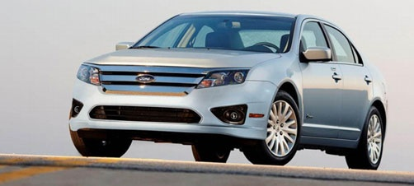
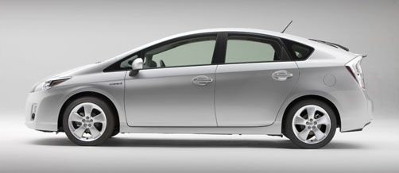
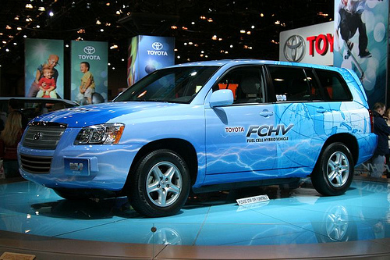
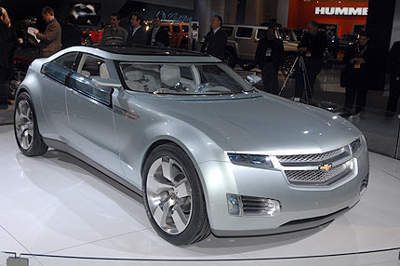
Hybrid Vehicles What does the future look like?
Ben Komnick and Tim Janello
Southern Illinois University Carbondale
Department of Automotive Technology

Slide 2
Objectives
Hybrid Overview
History
Presently Available
Obstacles
Future Outlook

Slide 3
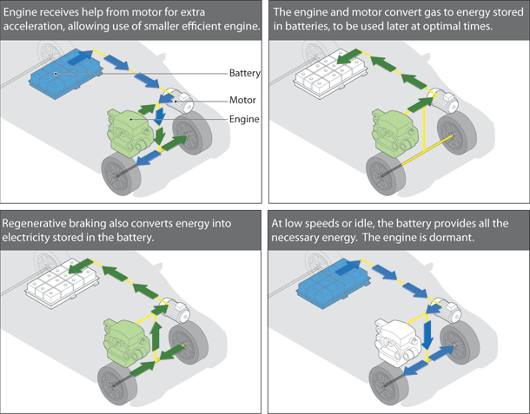
What is a Hybrid Vehicle?
A vehicle using two or more different types of energy power sources for propulsion.
Most common is petro/electric.
Most Prominent in the US is Gasoline/Electric
Europeans are looking towards Diesel/Electric

Slide 4
Electric Motors
Advantages:
High Torque – Low RPM
Efficient Acceleration
Generator Braking
Drive Wheels without ICE (parallel)
Disadvantages:
Cost
Weight
Batteries
Motors/Generators

Slide 5
Gas Engines
Advantages:
Small – Light Weight
Efficient
Supplements Acceleration
No Idle Time (start/stop) or Decel
Drive Wheels without Motor (parallel)
Disadvantage:
Gasoline Cost
Emissions

Slide 6
Full
Can start off silently with electric motor only
Engine
starts on demand
shuts off when decel or stopped
Toyota Prius/Camry, Ford Escape, Nissan Altima

Slide 7
Mild
Must use engine to launch
Engine shuts off when decel or stopped
Electric motor used for additional power
Chev. Malibu, Saturn Vue, Honda Civic/Accord
Sub-categories
Start/stop
ISAD (Integrated Starter Alternator w/Dampening)
IMA (Integrated Motor Assist), larger

Slide 8
Full or Mild
Both need engine at higher speeds
Both use electric motor to
assist braking
charge batteries (“re-gen. braking”)
Neither requires plug-in

Slide 9
Parallel vs. Series
Parallel
Both engine & motor can drive vehicle independently
All current hybrids
Series
Engine never drives the vehicle directly
Engine drives generator
Generator to motor or batteries
Chev. Volt

Slide 11
Other Hybrids
PHEV
Can be plugged in (not reqd.)
10-50 mi. range elec. only
Chev. Volt, Saturn Vue, Cadillac Converj, Fisher Karma, Venture One, Plug-in Prius
Hydrogen Fuel Cell
Toyota Highlander, Ford Edge, Honda FCX Clarity, etc.

Slide 12
History
1839
The First Electric car by Robert Anderson
1890-1910
Rapid improvement in lead-acid batteries
1898
Porsche’s hybrid with engine-generator/motor set
1916
Baker and Woods offered hybrids (35mph @48mpg)
1966
US Congress recommends hybrids for emissions reduction
1974
Victor Wouk used a 69 gas-electric Buick to meet EPA requirements
1996
GM’s EV1 introduced in California on a lease
Removed and all but a few crushed by 2003
1997
Toyota introduced the Prius
Audi started production of the Audi Duo

Slide 13
Today’s Hybrid Market

Slide 14
Presently Developed
Petro-Electric Hybrids
Hydraulic Launch Assist
Petro-Air Pressure Hybrid
Found in:
Cars
Medium Duty Trucks (city use)
Delivery
Trash
Utility
School Buses

Slide 15
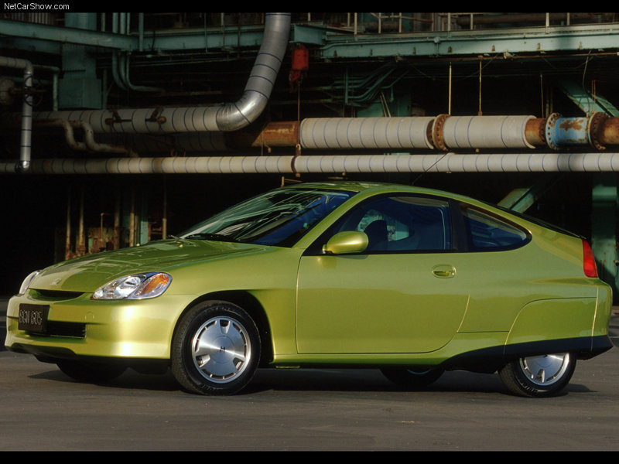
Honda Insight
2000
Introduced in December, 1999
Delivered 52 MPG urban driving
Delivered 60 + Highway MPG
Two Seater
144V nickel-metal hydride (Ni-MH) Main Battery

Slide 16
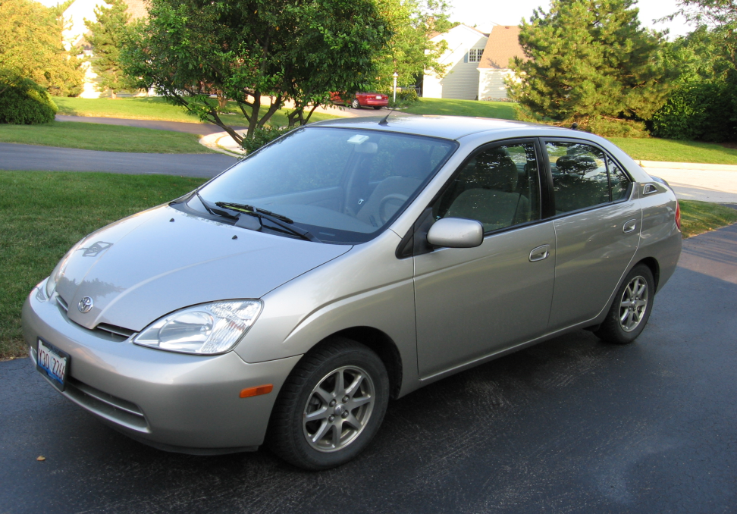
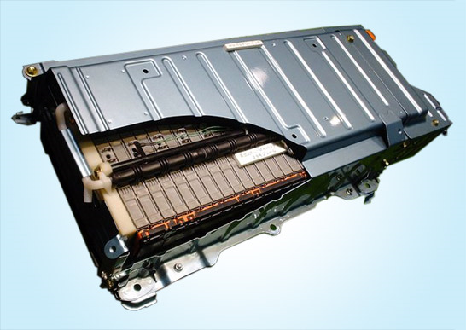
Toyota Prius 2001-2003
Generation II
Introduced here in August, 2000
Delivered 52 MPG city and 45 MPG highway
Four door sedan
273.6 V nickel-metal hydride (Ni-MH) Main Battery
228 cells ({1.2V x 6 cells} x 38 modules)
60 to 70 watt-hours /kilogram
Battery = 115 lbs
Gel type
Potassium/sodium hydroxide
pH of 13.5

Slide 17
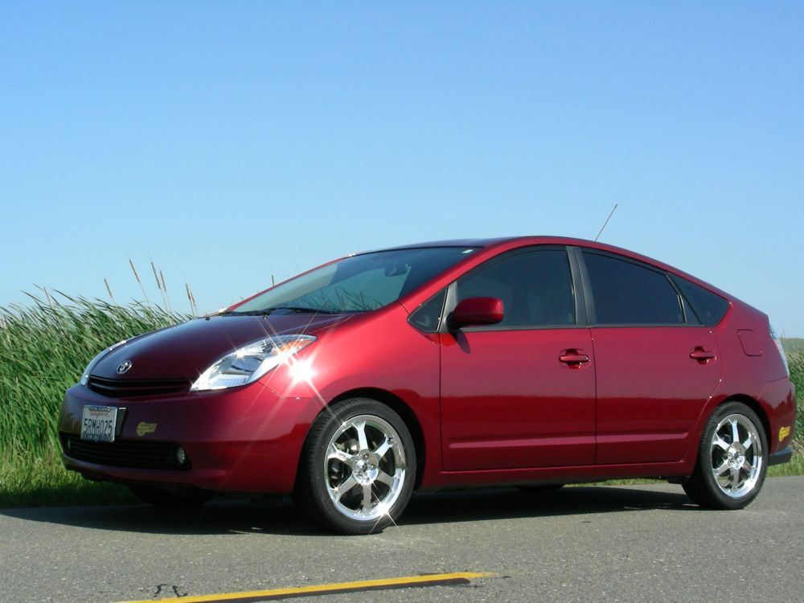
Toyota Prius 2004-2009
Generation II
201.6V Static Voltage
Only 28 modules
3-Phase operation @500V
Battery = 86 lb

Slide 18
Hybrid Investment Recovery Purchase

Slide 19
Hybrid Investment Recovery Fuel Economy

Slide 20
Hybrid Investment Recovery Fuel Consumed per Year

Slide 21
Hybrid Investment Recovery Time to Start Paying Off

Slide 22
Hybrid Investment Recovery Fuel Saving to Cost

Slide 23
Hybrid Investment Recovery Years to Recovery

Slide 25
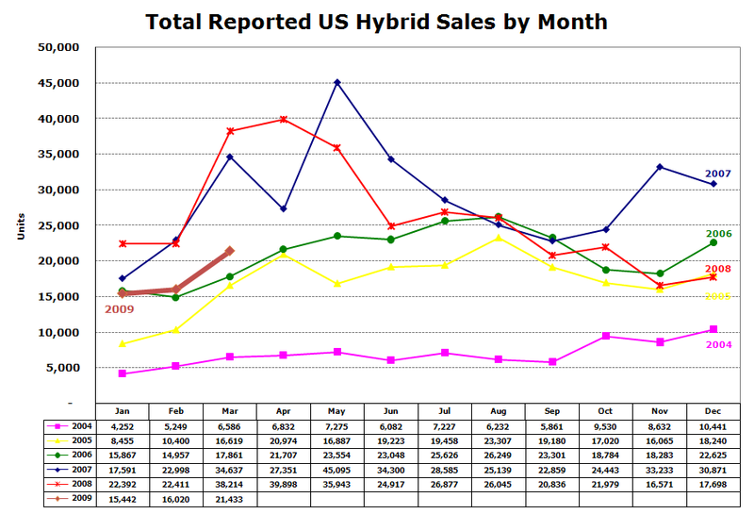
Hybrid Vehicle Sales
Echo Gasoline Prices.
Availability
Of Hybrids Hurt Sales in June/July 08.
Courtesy of Green Car Congress

Slide 26
Hybrid’s Future Depends on Battery Technology

Slide 27
Lithium Ion Hybrid Batteries Li-ion
Problems:
Battery life
Battery Temperature
Solution:
Cell Material
Separator Material for Safety.
Laminated Packaging for Thermal efficiency.
Result :
110 to 130 watt hours per kilogram Li-ion Battery

Slide 28
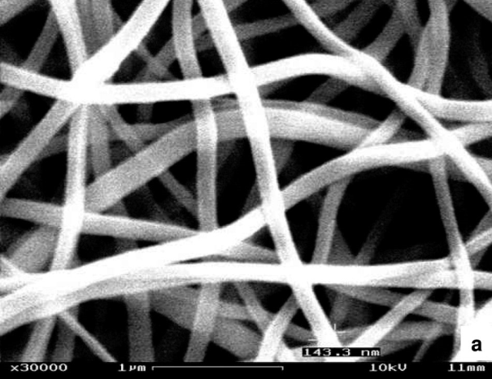
NANOWIRE Battery
10 X the charge of existing lithium-ion batteries.
Li-ion anode (carbon) & cathode (metal-oxide)
Carbon holds 1 ion per 6 carbon atoms.
Problem:
Silicon anode holds 4.4 ions per silicon atom but breaks.
Solution:
Silicone Nanowires (100-nanometer-wide ).

Slide 29
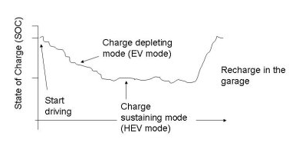
Chevy Volt
Series Hybrid
40 Miles on Single Charge
0-60 in 8.5 sec.
400 lbs. Battery Weight
6.5 hrs. to Full Charge.
Battery Life of 10yrs. or 150K mi.
1L 3cyl. Turbocharged Engine Turning a 53KW Generator.
120KW electric motor
12 gal. of Gasoline Extends Range to 600 mi.
$9,000 Projected Battery Cost.

Slide 30
popsci.com

Slide 31
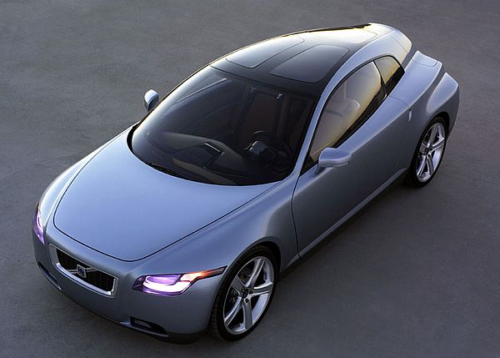
Volvo 3CC Car
3,000 lithium ion cells
Each one the size of a common "AA" battery
105 horsepower with absolutely zero emissions
modifiedcars.com

Slide 32
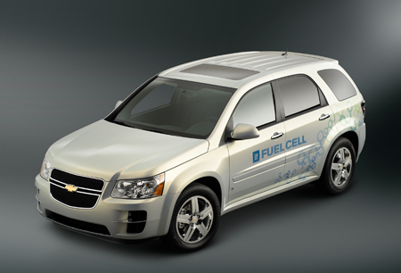
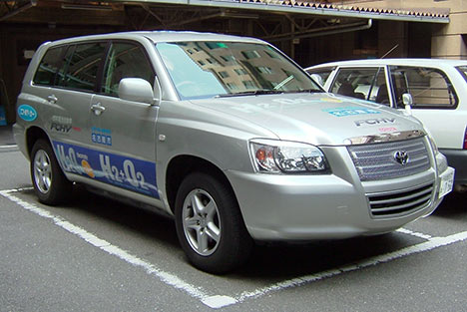
The Future

Slide 33
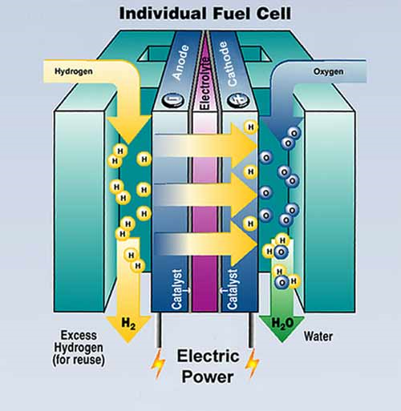
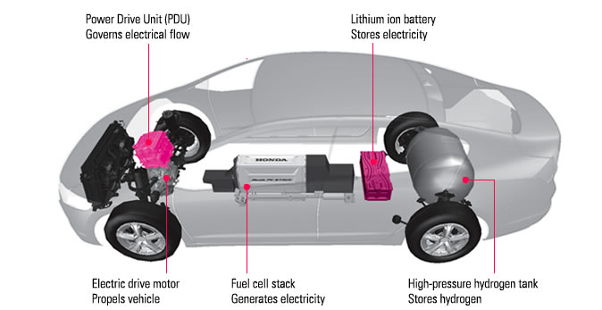
Fuel Cells
Fuel Cell Hybrid Vehicles
Production Time Line
2012 - 2015
Toyota FCHV
472 mi. range
GM “Sequel”
0-62 in 10 sec.
300 mi. range
Mercedes Benz “F600”
2.9 L / 62 mi.
250 mi. Range
Most all Manufacturers Involved
Problem:
Cost of Platinum

Slide 34
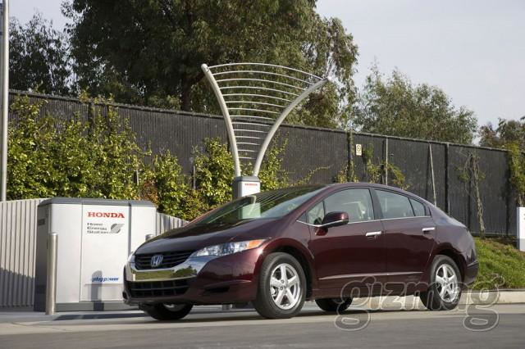
Honda
FCX Clarity
Launched in 2008 (California only)
3 yr. Lease @ $600/month including maintenance.
280 mile range.
Home Energy Station provides Hydrogen
Uses Natural Gas
Provides home owners with Heat, Hot Water, and Electricity.
FCX reduces CO2 by 30%
Energy Station saves 50% on Electricity.

Slide 35
Hydrogen in Dollars
Presently-
Cost if produced by Wind Power
$6.98 per kilogram
Hydrogen Fuel Cell
1 kg Doubles the Mileage of 1 gal Gasoline.
$3.49 /gal gas = $6.98/ kg of hydrogen
Future Projection:
$2-2.50/kg
Source: hydrogendiscoveries.wordpress.com

Slide 36
Water for Hydrogen Production
2.4 gal of water produces 1kg of Hydrogen
1-2.5 gal of water per gallon of Gasoline
If 1kg of Hydrogen = 2 gallons of gasoline
2 X 1-2.5 gal. = 2-5 gal of water (3.5 avg.) for same mileage.
2.4 gal vs. 3.5 gal?????

Slide 37
Questions?

